Slide 1

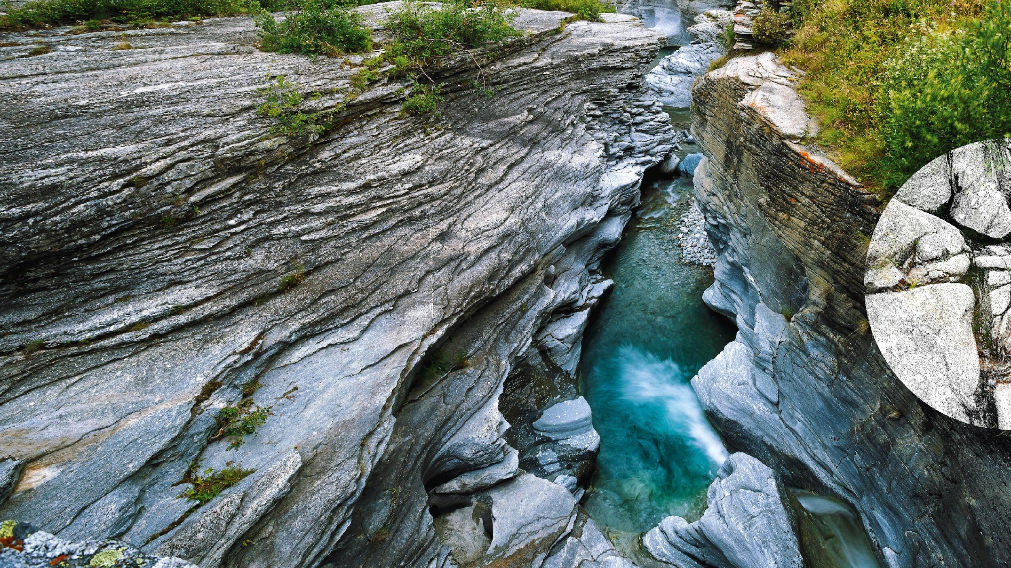


Achieving FAIR water quality data exchange thanks to international OGC water standards
Sylvain Grellet – BRGM
09/05/2024 - ESIP - Information Technology and Interoperability Deep Dives
With support from
Hylke van der Schaaf - Fraunhofer IOSB
Katharina Schleidt - DataCove

Slide 2
Achieving FAIR water quality data exchange thanks to international OGC water standards

Slide 3
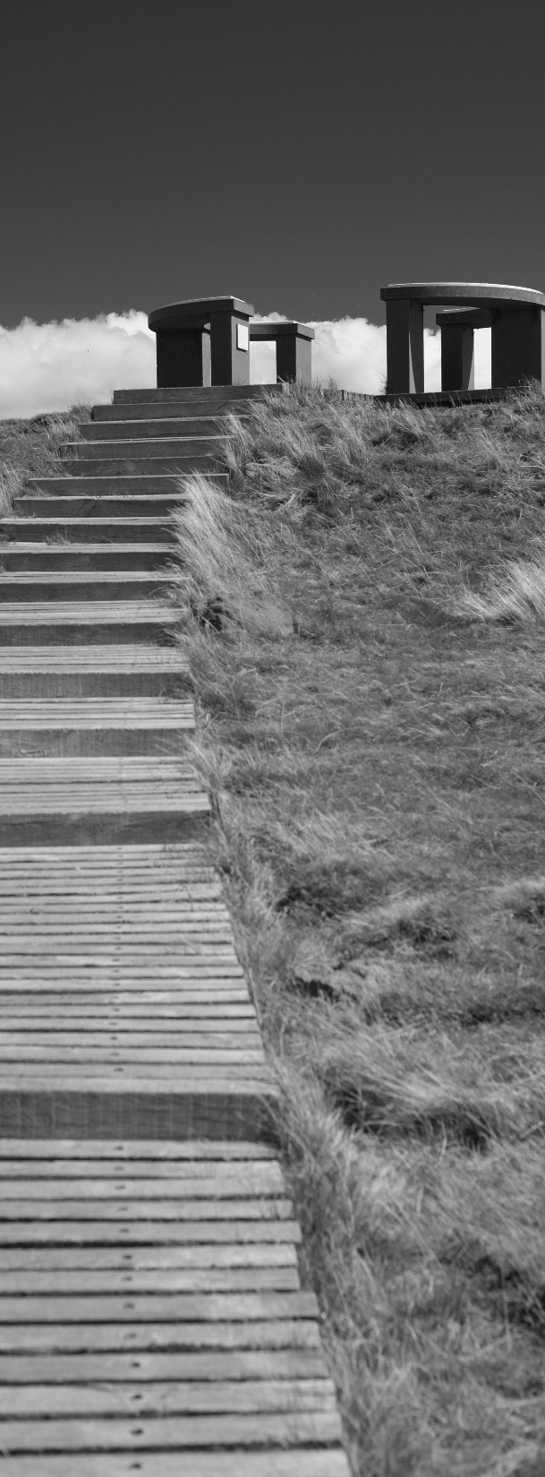
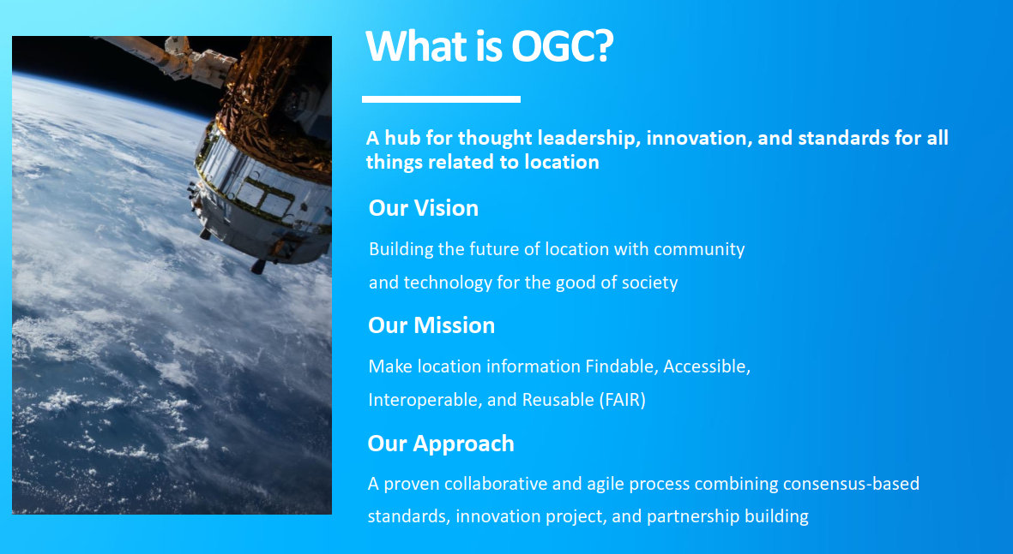

Slide 4
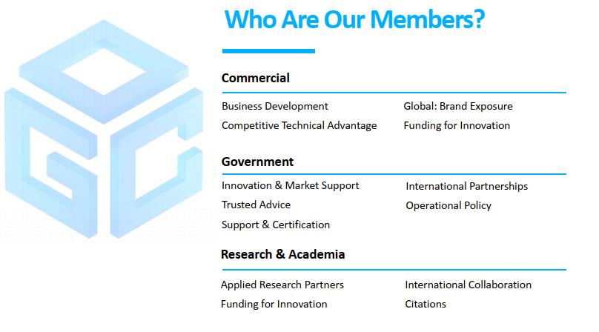

Slide 5

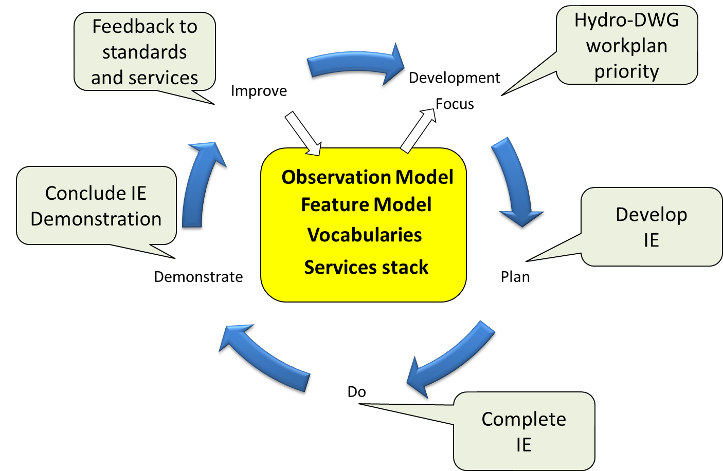
OGC Hydro Domain Working Group ?
Joint OGC – World Meteorological Organization (OMM / WMO) group
Memorandum of Understanding between OGC - WMO
Target: water data standards => WaterML 2.0 suite : https://www.ogc.org/standard/waterml/
Organizing Interoperability Experiments - (IEs) focused on the water sub-domains
Entry point
https://external.ogc.org/twiki_public/HydrologyDWG/WebHome
Has a Research Data Alliance ‘sister group’
=> ‘Global Water Information Interest Group’
Chairs
Tony Boston (Australia)
Silvano Pecora (Italy) – WMO Liaison
David Blodgett (USA)
Iterative Development
http://www.opengeospatial.org/projects/groups/hydrologydwg

Slide 6
Group dynamics
A long history of joint activities
2003 - Earth Systems Science Domain Working Group (DWG)
2009 - Hydrology DWG
2011 - Groundwater Interoperability Experiment (IE)
2011 - Water Information Services Concept Development Study
2011 - Surface Water Interoperability IE
2012 - Hydrology Forecasting IE
2013 - Climate-Hydrology Information Sharing Pilot
2013 - GroundWater IE2
2014 - Water ML 2.0 Standards Working Group (SWG)
2015 - Hydrographic Features SWG
2015 - Research Data Alliance Global Water Information IG (Hydro DWG sister group)
2016 - Groundwater SWG
2017 - Geoscience DWG
2018 - Environmental Linked Features IE (ELFIE)
2019 - Borehole IE
2021 - Second ELFIE (SELFIE)
2022 - Water Quality IE => on going

Slide 7
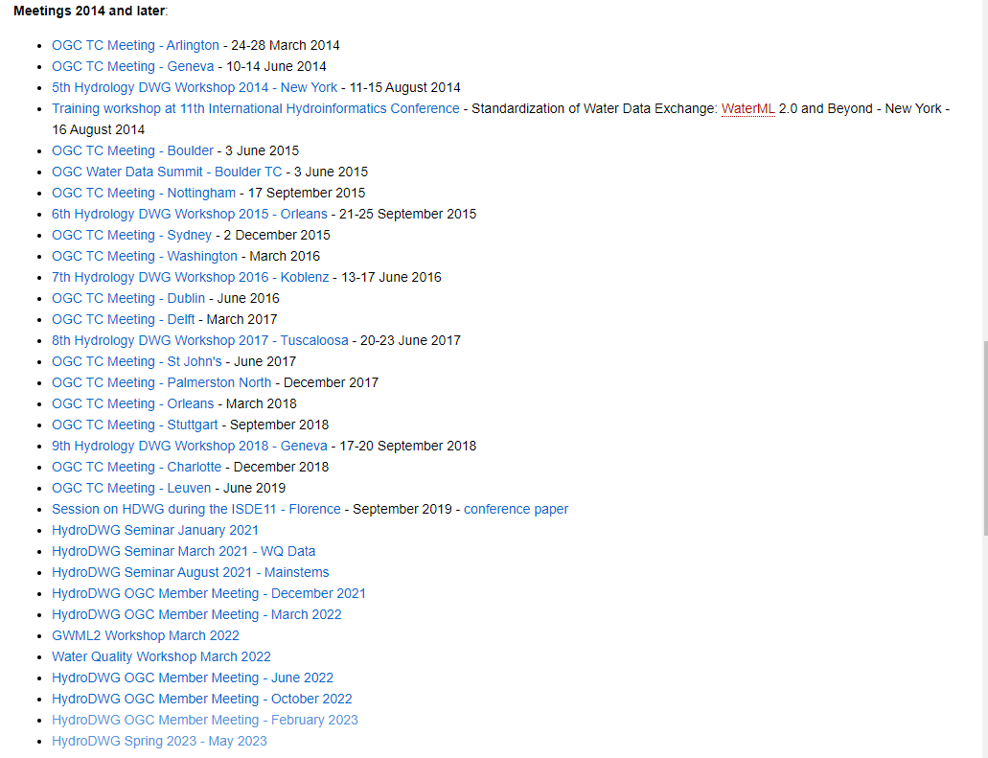
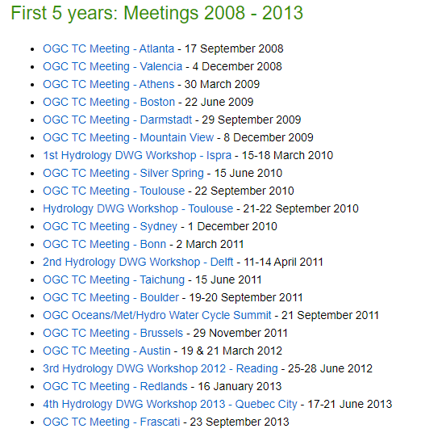
Group dynamics
Un long history of meetings

Slide 8
Group dynamics
Community
Members all across the world
Members from different organization types
Public administrations
Public research organizations
International organization
Private companies
Some examples
NR-Can, GSC, USGS, US EPA, CUASHI, SDSC, BRGM, UK CEH, DELTARES, GRDC, BaFG, Univ Tartu, Fraunhofer IOSB, DataCove, NIWA/LAWA (NZ), Federation University (Australia), BoM Australia, CSIRO, …
WMO, UNESCO, …
Kisters, 52°N, Aquatic Informatics, …

Slide 9
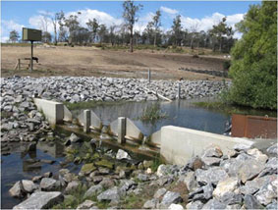
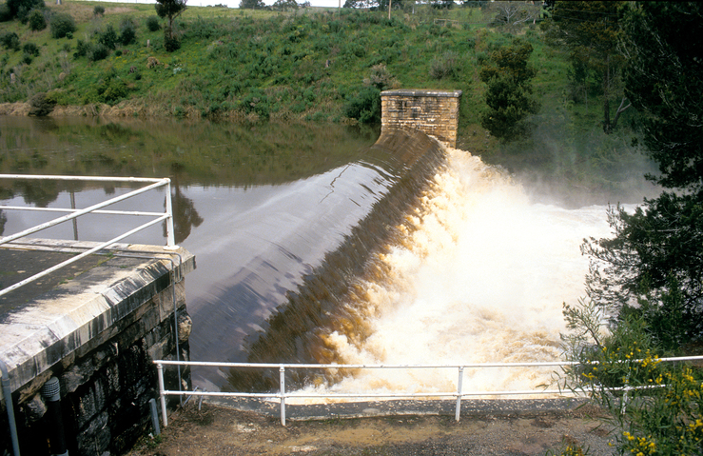
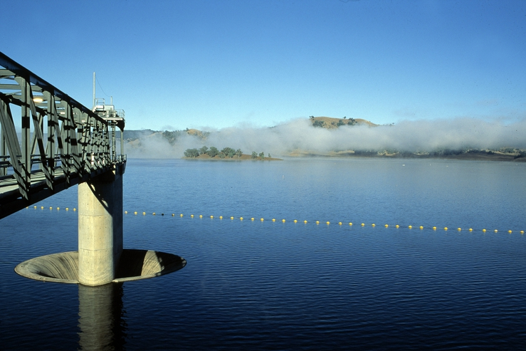
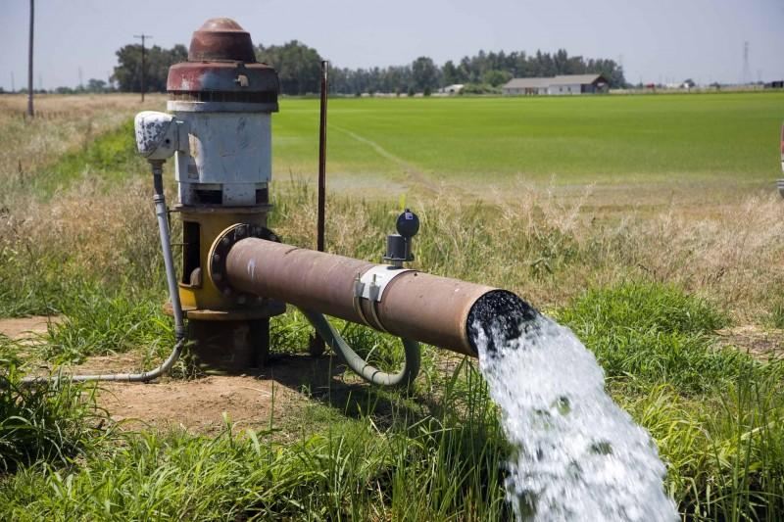
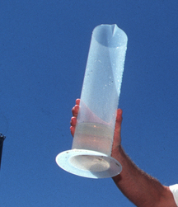
A suite of standards
WaterML2.0
Open and documented
implemented in WMO Information System and in many organizations : UNESCO, USGS, US EPA, NrCan, NIWA, BRGM, etc…
And in opensource tools : CUASHI Hydro-Server, Kisters, 52°N etc…
Updated with a regular contribution from projects involving Hydro DWG partners
Part 1 - Timeseries
Part 2 – Ratings, Gaugings and Sections
Part 3 – Surface water features
Part 4 – Groundwater
Part 5 –
Water quality (best practice)
Soon to be updated by the Water Quality IE
9

Slide 10
Achieving FAIR water quality data exchange thanks to international OGC water standards
=> The OGC Water Quality Interoperability Experiment

Slide 11
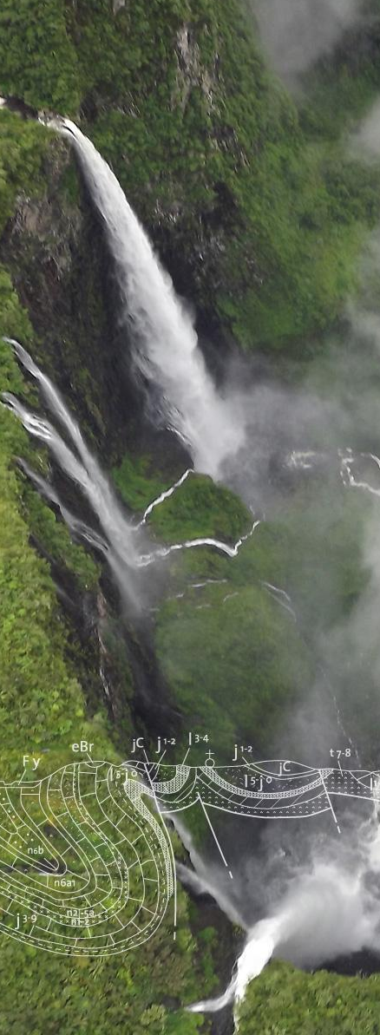
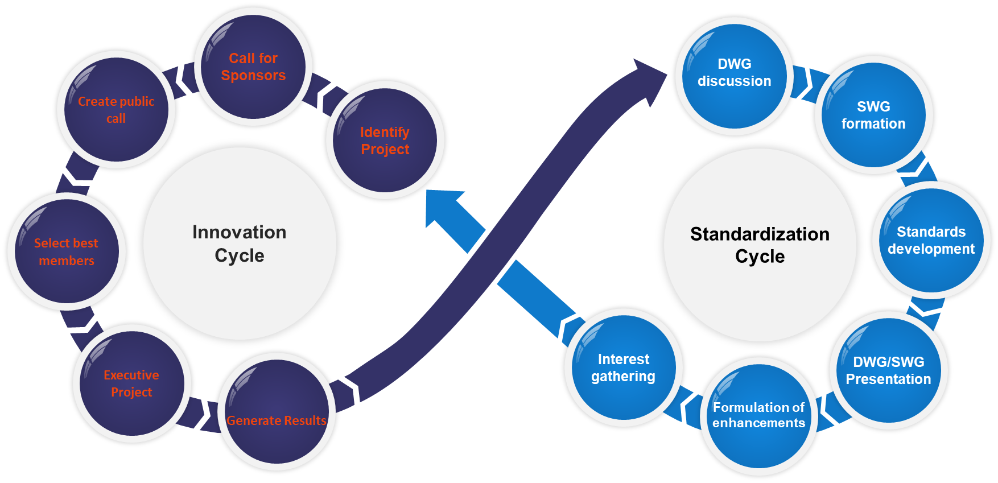
OGC Interoperability Experiment (IE) ?
OGC Innovation Continuum
Innovation Roadmap
Development (What)
Innovation Roadmap
Execution (How)
We are here

Slide 12
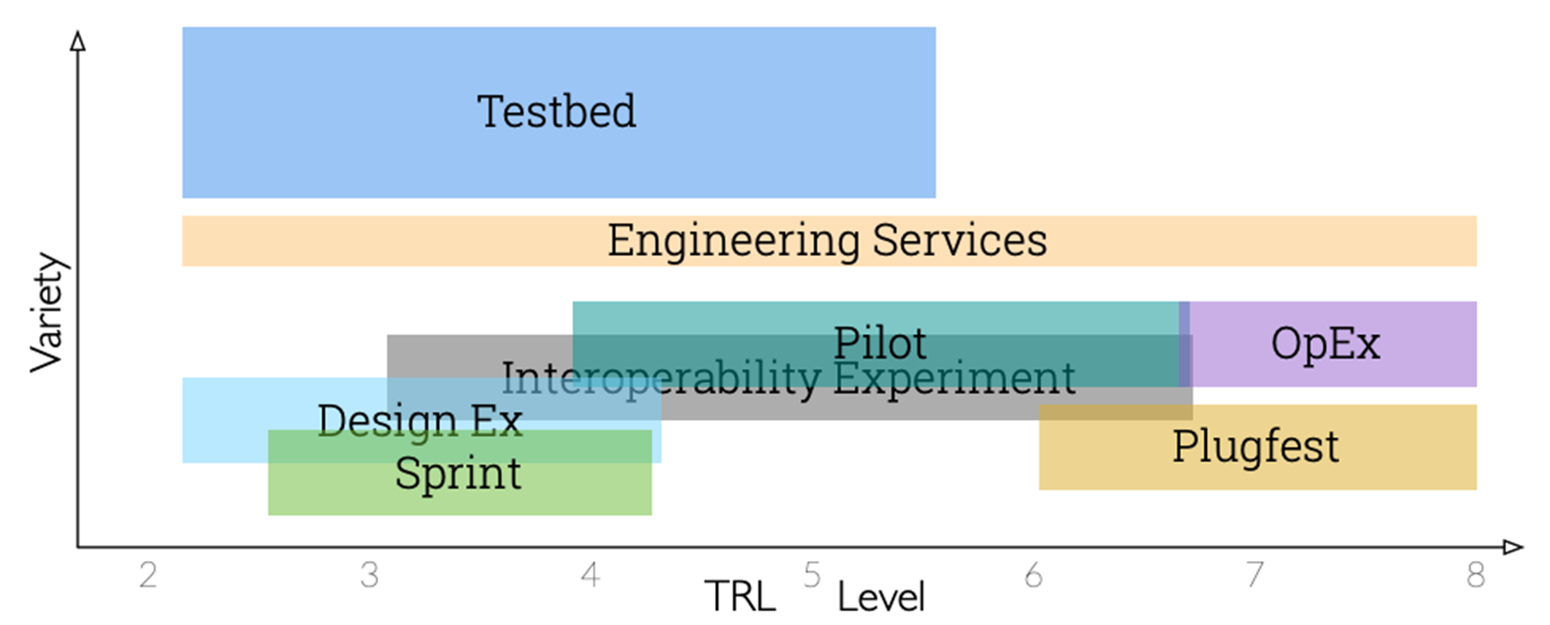
OGC Interoperability Experiment (IE) ?
We are here

Slide 13
OGC Interoperability Experiment (IE) ?
Applied research initiative led by OGC members and supported by OGC staff
Most of the time building on the current standards and best practices : the ‘OGC Baseline’ (pushing them to their limits / applying them to a new domain)
Non-OGC member participation is allowed (usually as observers)
In several IEs: GitHub + mailing list + meetings are open
so the ‘observers’ can be really active
Results documented in Engineering Report(s) or other OGC documents and generally used to define new Standardization work.
Some lead to Change Request to the ‘OGC Baseline’
Some to Best Practices in applying it
Some fill in gaps in the ‘OGC Baseline’ proposing document ready for the standardization process: exactly what happened to all the WaterML2.0 series of standards
It’s during the IE that the group decides what the output will be : through experimentation

Slide 14

OGC Water Quality IE set up
Third time the topic is proposed within the OGC Hydro Domain Working Group
Enough momentum and interest from parties
=> WMO-UNEP-WHO-UNESCO Water Quality workshop in March 2022 (29-31)
https://external.ogc.org/twiki_public/HydrologyDWG/WaterQualityWorkshopSprint2022
=> confirmation of the necessity and organizations interest. Identification of interested parties and IT challenges
Discussion on the best approach => an OGC Interoperability Experiment
Water Quality IE inception
Charter, call for participation, kick-off (20/09/2022)
Co-chairs : Sylvain Grellet (BRGM), Kyle Onda (Lincoln Institute)
Since then :
Starting point : https://github.com/opengeospatial/WaterQualityIE
Weekly meetings
Shared material
Rolling meeting minutes document,
One focal point for UML models
Shared deployment documentation initiated
Note : shared images in that presentation represent Work In Progress currently being tested
The Engineering Report will summarize the group conclusions

Slide 15
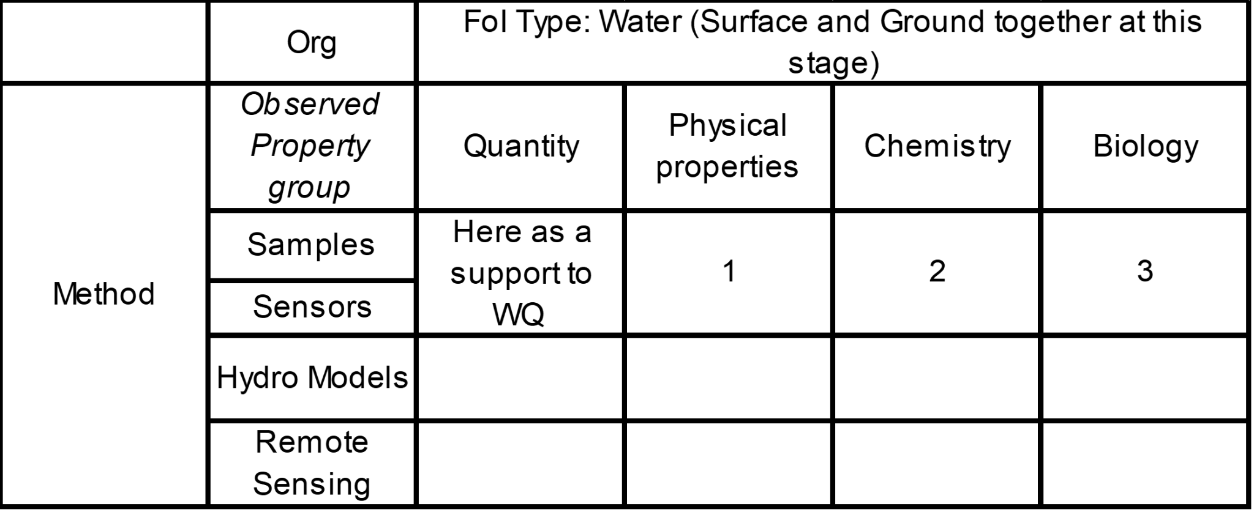
Use Cases identification and work methodology
FoI = Feature Of Interest = the real world feature on which observation is made
Water Quality Use Case prioritisation
Physical Properties (ex : Temperature, Conductivity), Chemistry
+ Water Quantity as a support to Water Quality
Out of scope this IE : Biology (taxa observation), Hydro Models, Remote Sensing

Slide 16
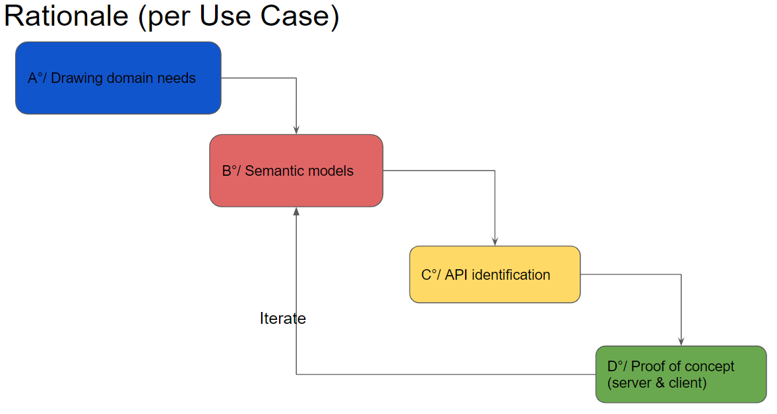
Use Cases identification and work methodology

Slide 17
FAIR water quality data exchange thanks to international OGC water standards

Slide 18
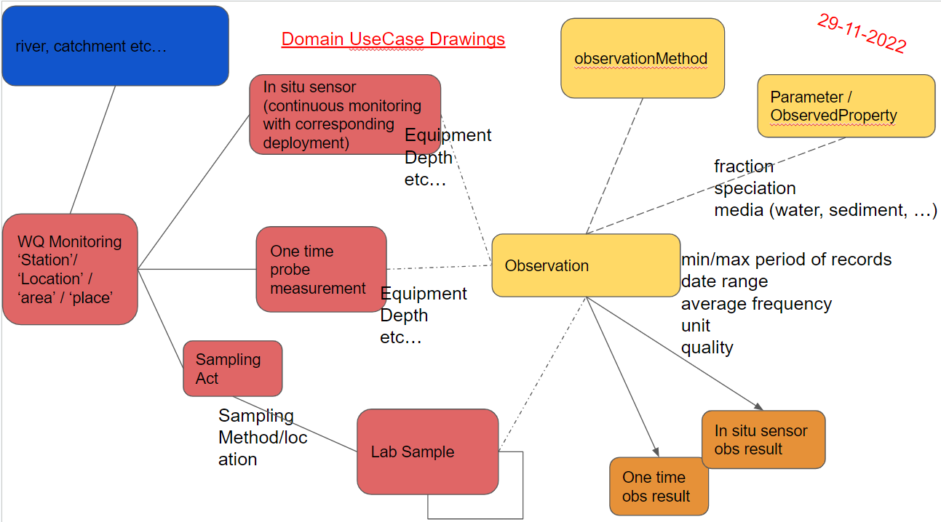
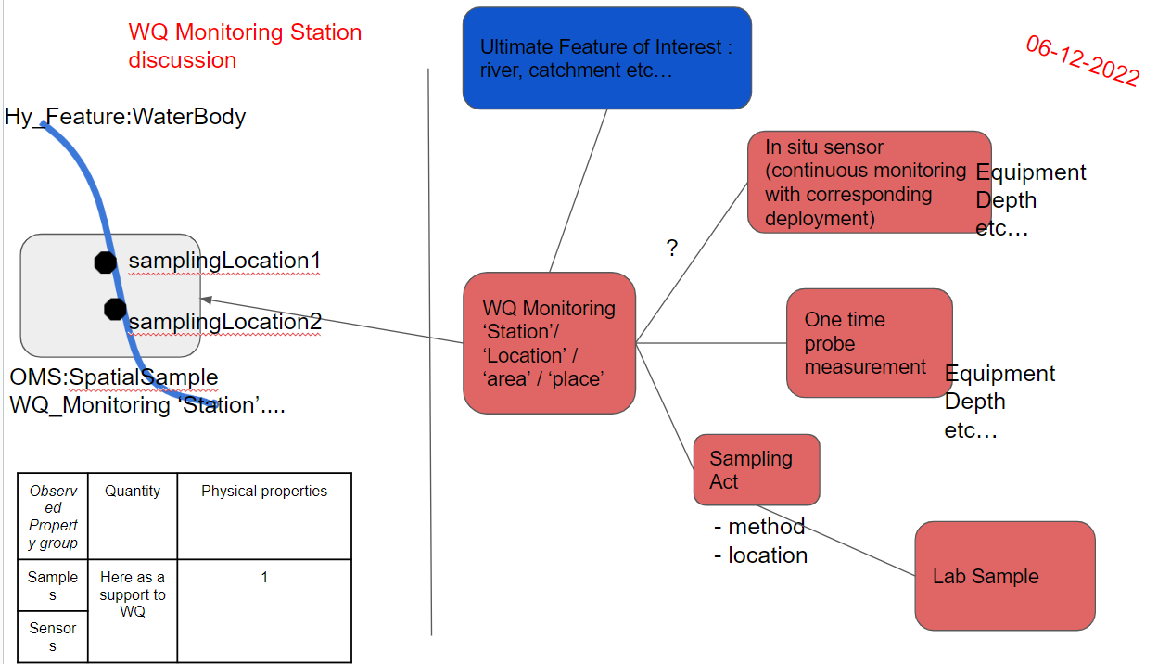
Conceptual Modelling
Step 1°/ Express the domain need stemming from the UseCases

Slide 19
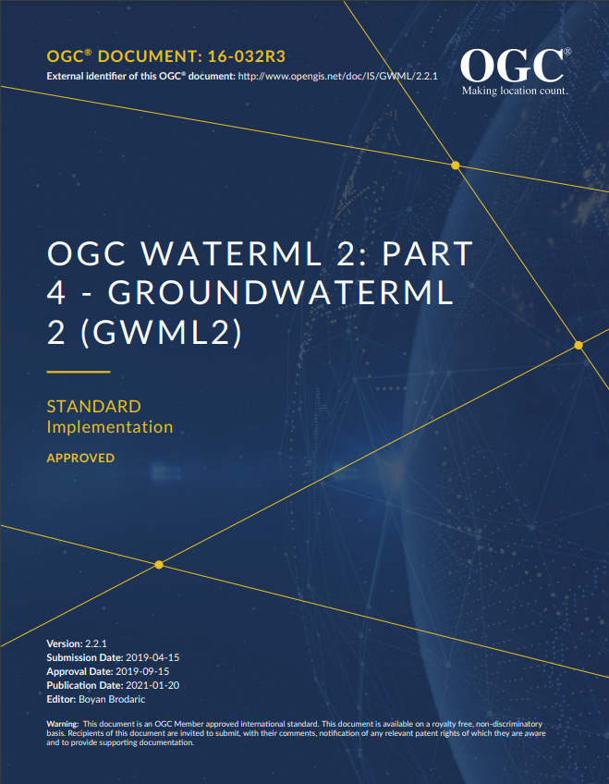
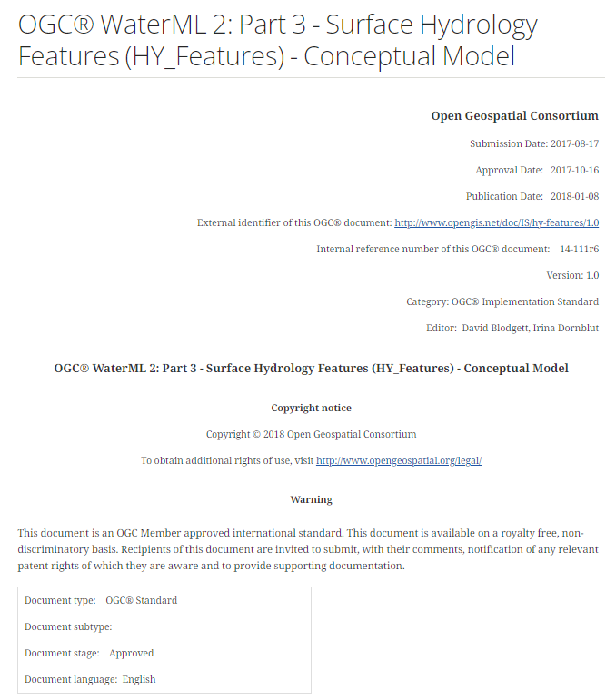
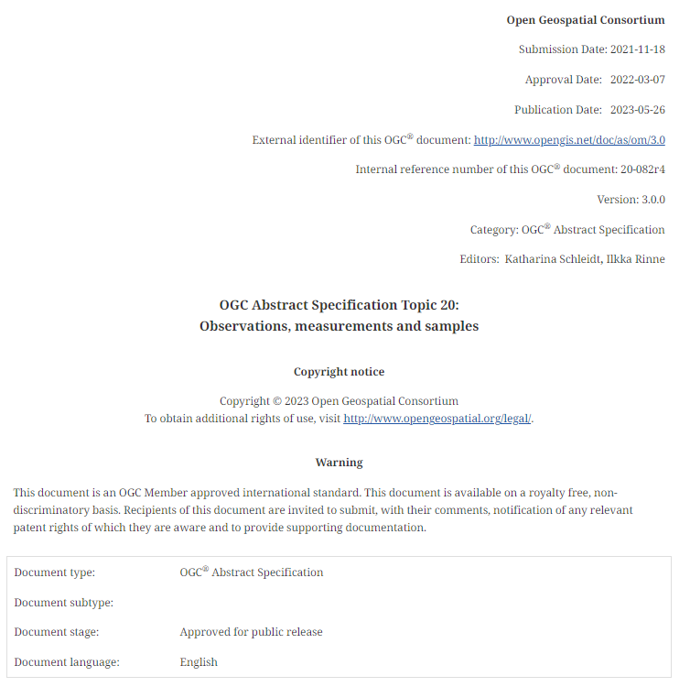
Conceptual Modelling
Step 2°/ Identify the standards in the OGC standard baseline to build on
2 OGC-WMO water standards : GroundWaterML2.0 & HY_Features
THE OGC-ISO standard for Observations & Samples : ISO 19156:2023 : Observations, measurements and samples

Slide 20
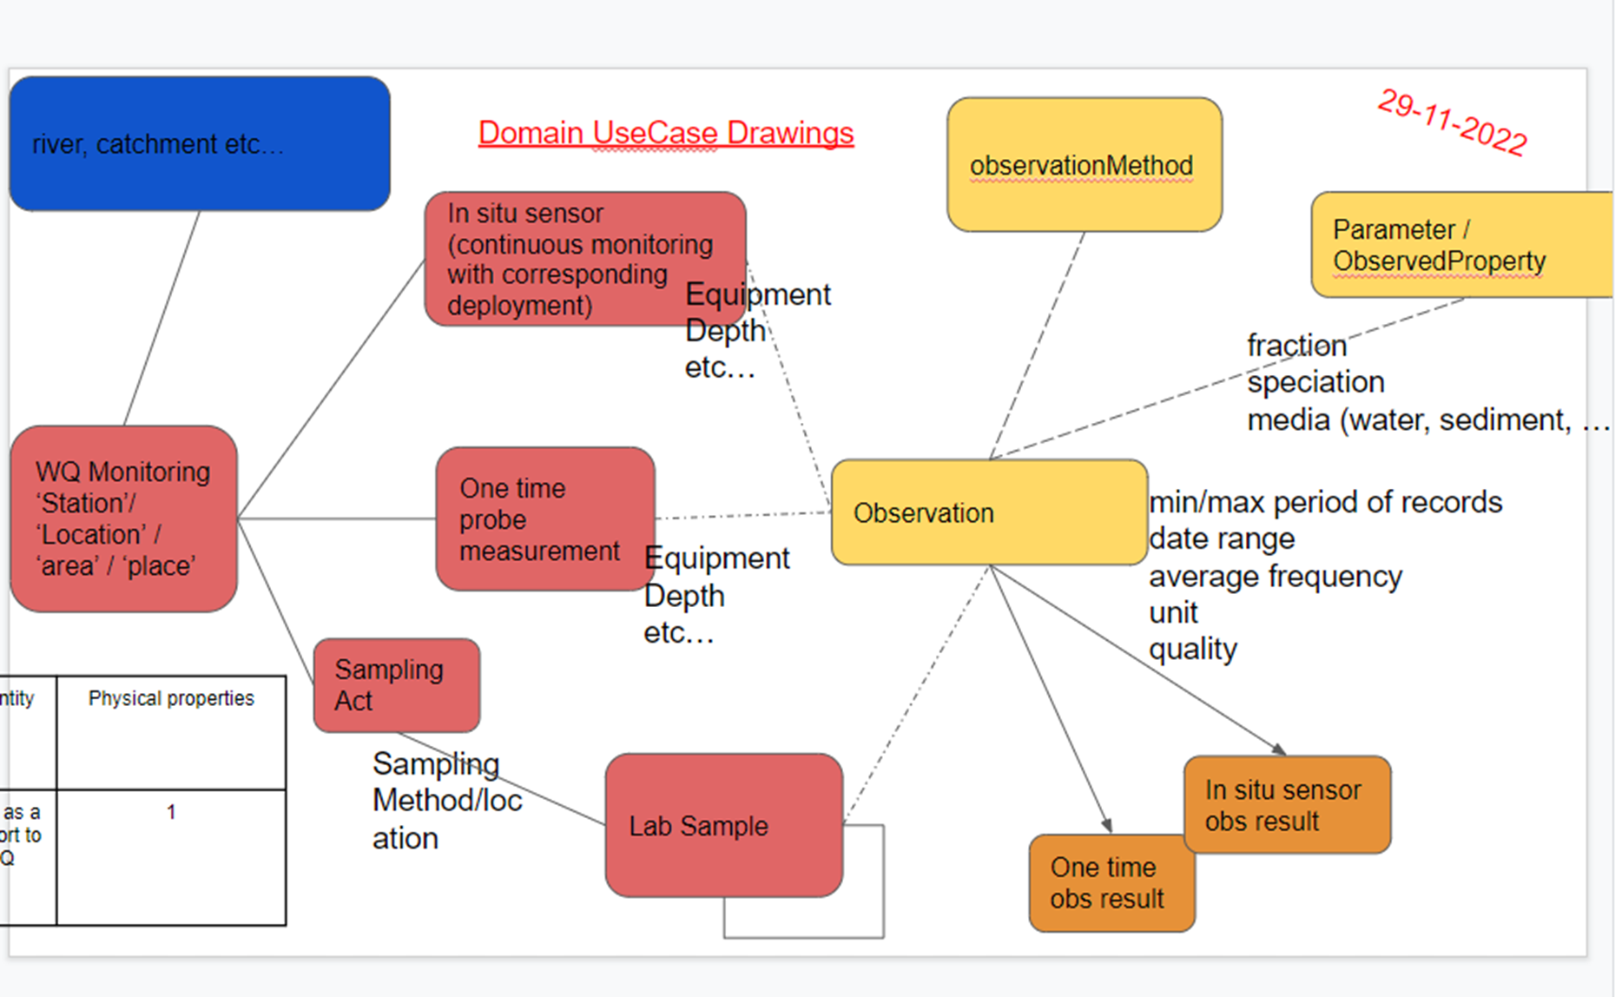
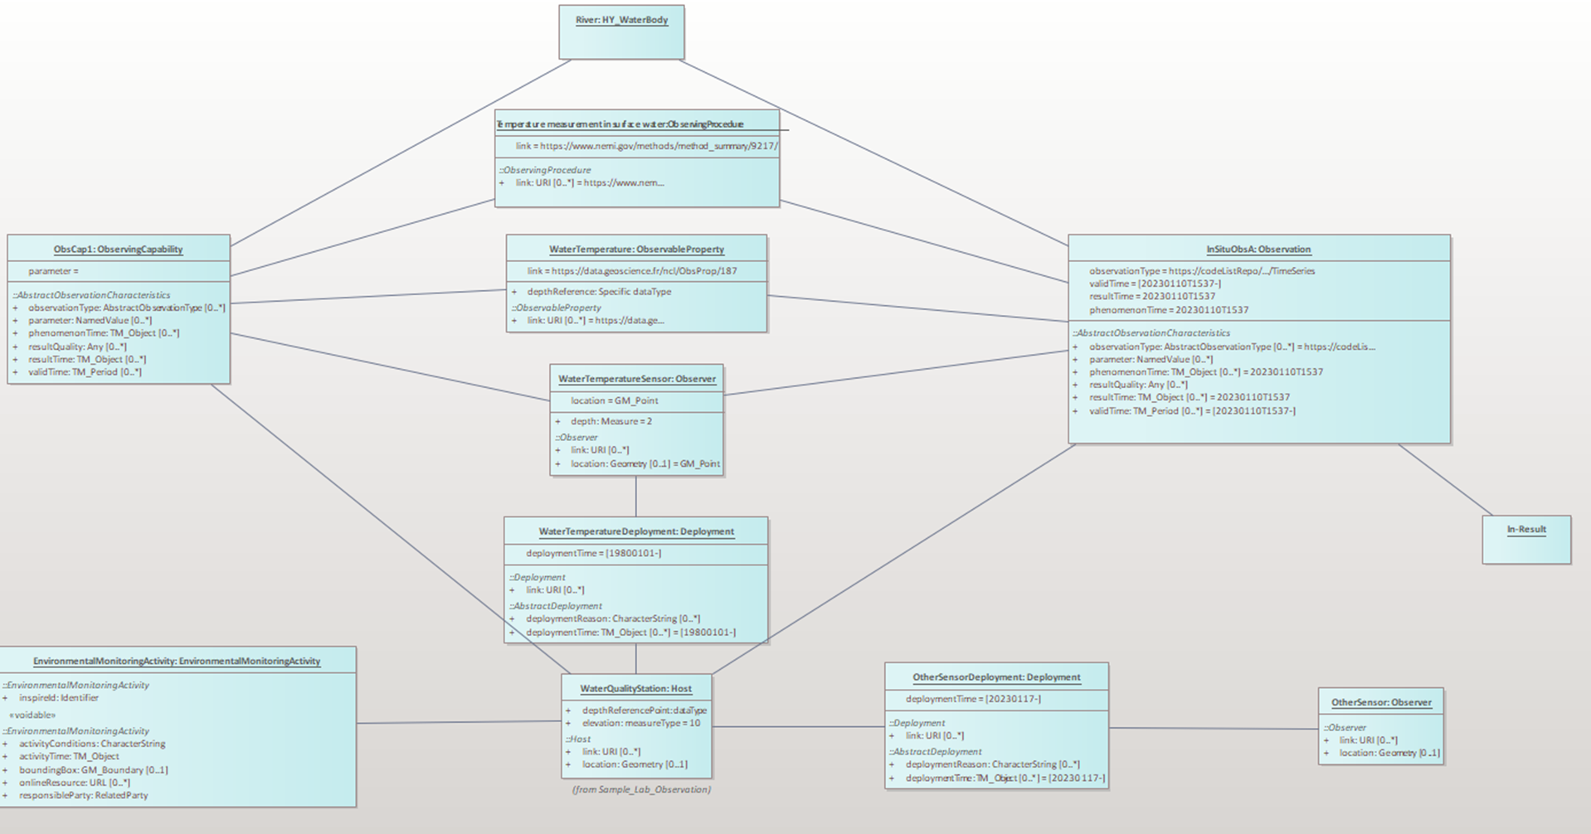
Conceptual Modelling
Step 3°/ Express domain needs according to the OGC standard baseline
=> Almost everything is in, just need to agree on how to use it
=> mainly UML “Object diagrams exercise” to document the use of the standards
FROM
TO

Slide 21
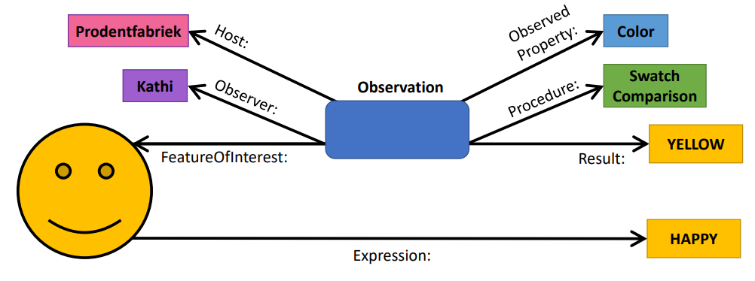
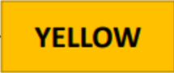
Conceptual Modelling
Backbone to build on: OGC/ISO 19156 (2023) : Observations, measurements and samples (a.k.a OMS)
OMS approach
vs.
‘Basic’ approach
Color:
Credits: Kathi Schleidt, DataCove
https://www.youtube.com/watch?v=bYDSgs2fKLk

Slide 22
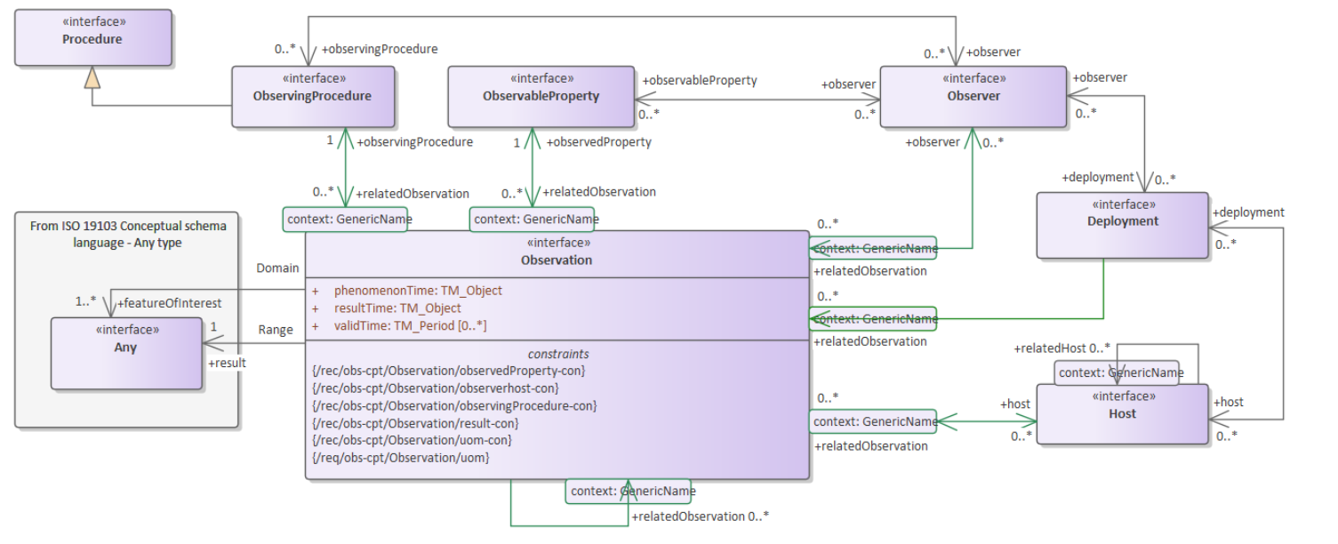
Conceptual Modelling
Backbone to build on: Observations, measurements and samples
Conceptual Observation schema

Slide 23
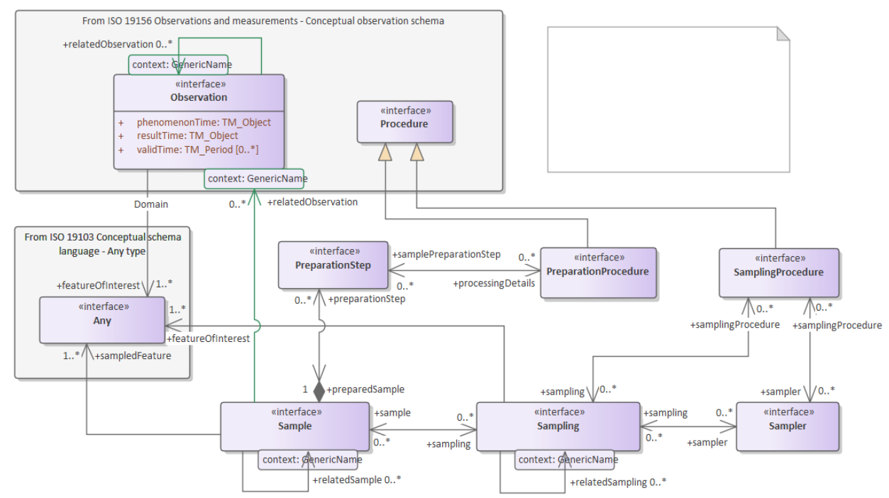
Conceptual Modelling
Backbone to build on: Observations, measurements and samples
Conceptual Sample schema

Slide 24

Conceptual Modelling
Work organised around the identified UseCases
Everything available online : https://umltool.ogc.org/login.php
Follow this path /OGC IEs/ WaterQuality_IE/ WaterQuality_Instance
Ground Water (GW)
GW_InSitu_QuantityObservation
GW_InSitu_QualityObservation
GW_ExSitu_QualityObservation
Surface Water (SW)
SW_InSitu_QuantityObservation
SW_InSitu_QualityObservation
SW_ExSitu_QualityObservation

Slide 25
Conceptual Modelling
2 modelling patterns
GW_InSitu_QuantityObservation < > SW_InSitu_QuantityObservation
GW_InSitu_QualityObservation < > SW_InSitu_QualityObservation
GW_ExSitu_QualityObservation <> SW_ExSitu_QualityObservation
In situ sensor
Ex situ = Laboratory

Slide 26
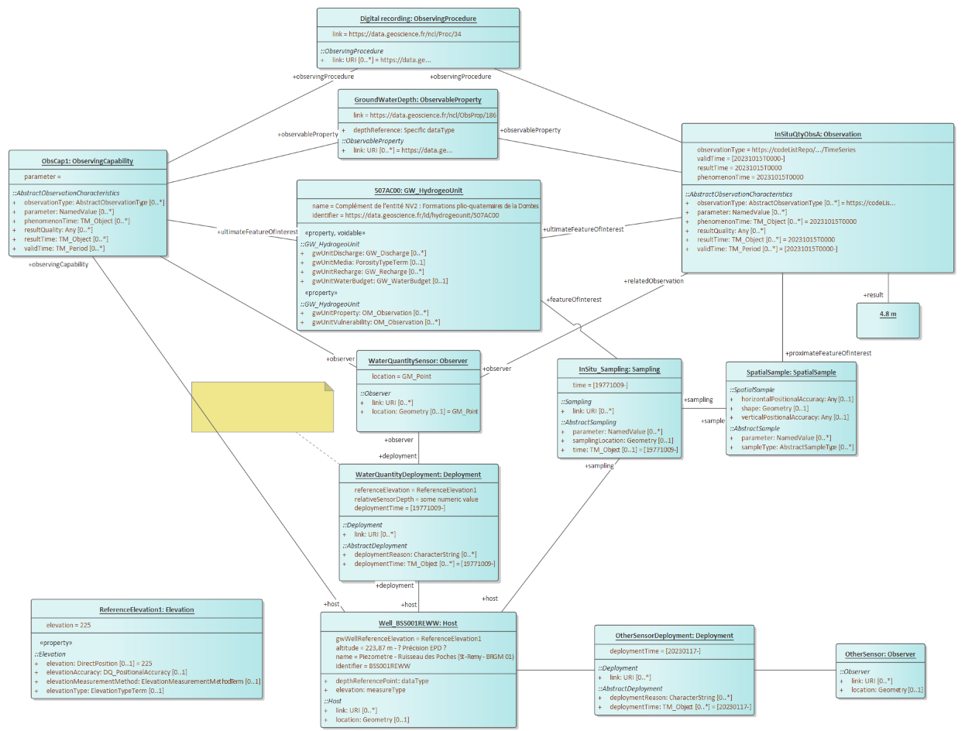
Conceptual Modelling
In situ sensor
GW_InSitu_QuantityObservation (water level)
Observing Procedure
Observed
Property
Observation & Result
Well & Sensor Observing Capability
Hydro Geo Unit
Sensor
Spatial Sample
Deployment
Well

Slide 27
Conceptual Modelling
In situ sensor
GW_InSitu_QuantityObservation (water level)

Slide 28
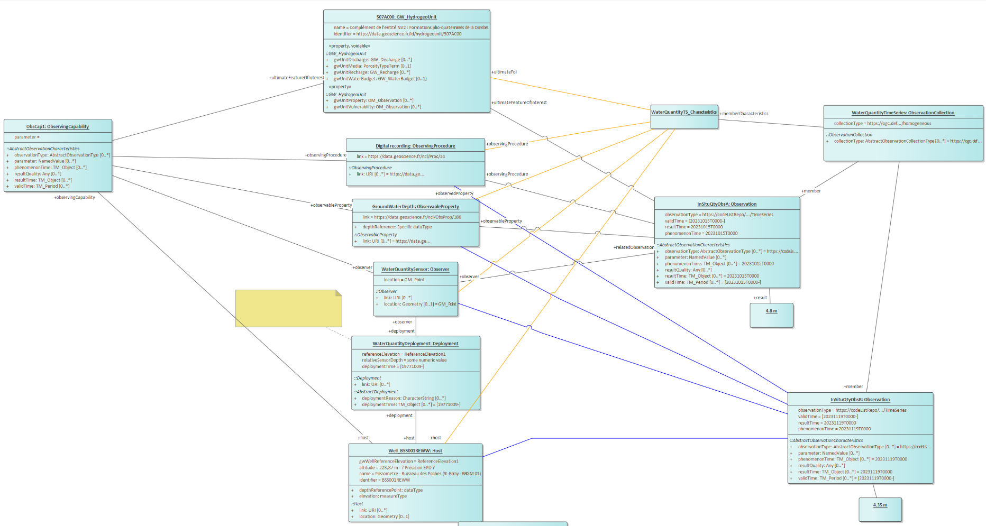
Conceptual Modelling
In situ sensor
GW_InSitu_QuantityObservation (water level)
TimeSeries Characteristics
Observation Collection: TimeSeries
Observation 1°/ & Result
Observation 2°/ & Result

Slide 29
Conceptual Modelling
In situ sensor
GW_InSitu_QuantityObservation (water level)

Slide 30
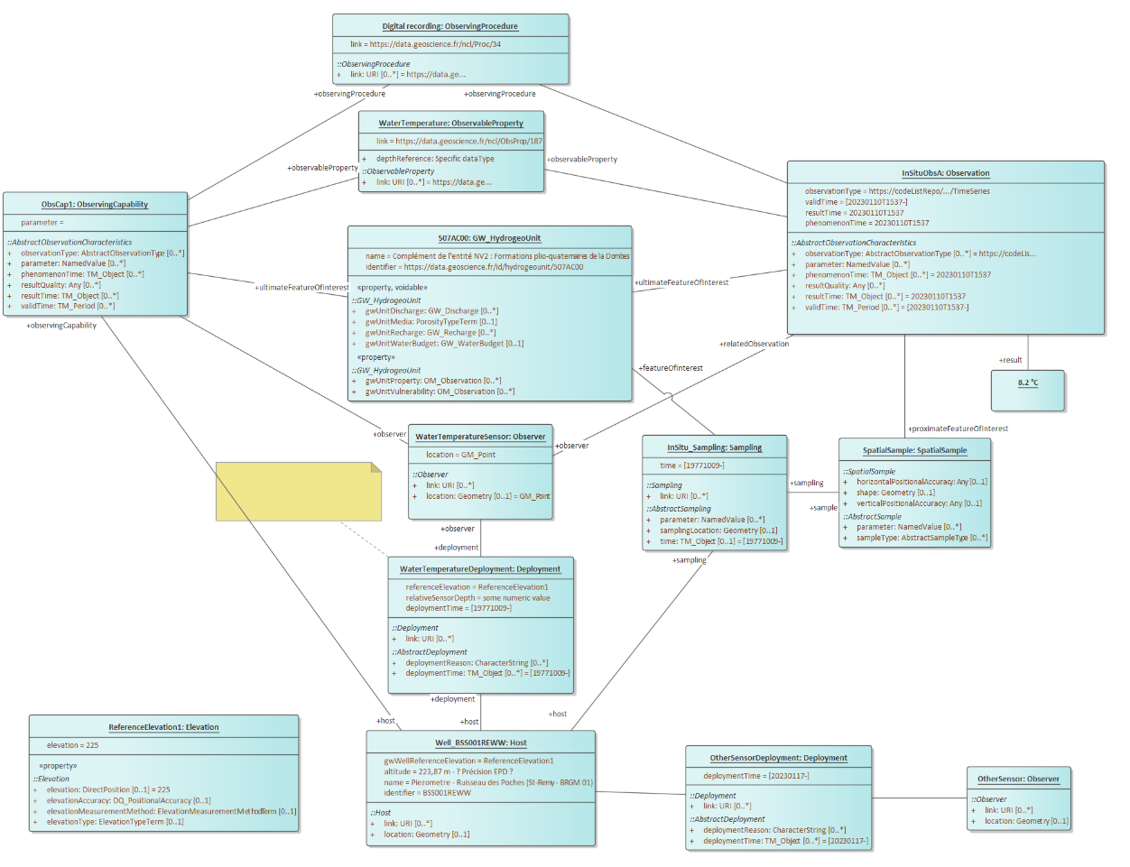
Conceptual Modelling
In situ sensor
GW_InSitu_QualityObservation (temperature) => same pattern

Slide 31
Conceptual Modelling
In situ sensor
GW_InSitu_QualityObservation (temperature) => same pattern
Observing Procedure
Observed
Property
Observation & Result
Well & Sensor Observing Capability
Hydro Geo Unit
Sensor
Spatial Sample
Deployment
Well

Slide 32
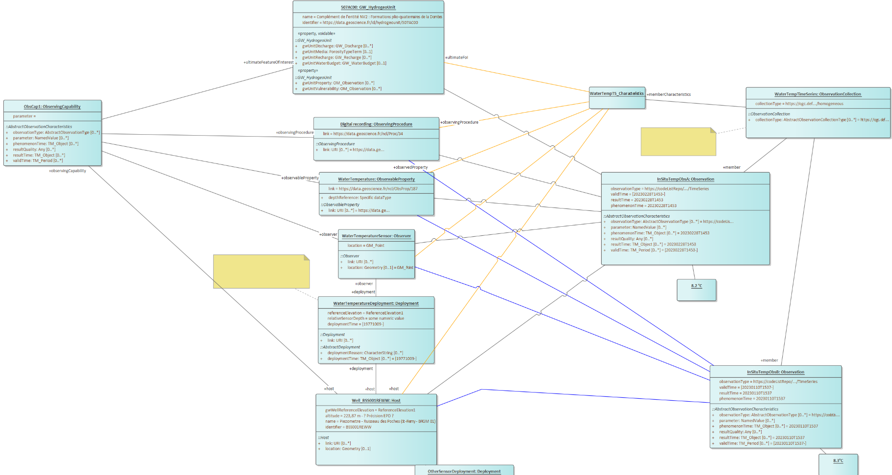
Conceptual Modelling
In situ sensor
GW_InSitu_QualityObservation (temperature) => same pattern
TimeSeries Characteristics
Observation Collection: TimeSeries
Observation 1°/
& Result
Observation 2°/ & Result

Slide 33
Conceptual Modelling
In situ sensor
GW_InSitu_QualityObservation (temperature) => same pattern

Slide 34
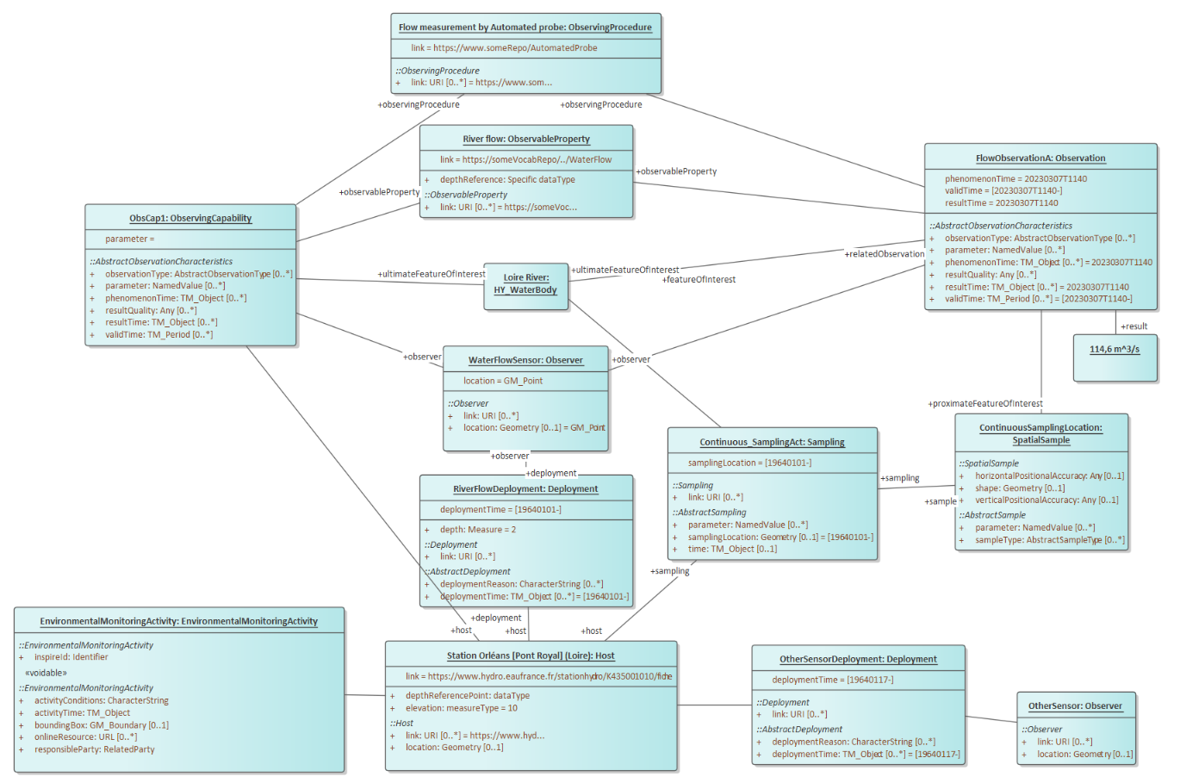
Conceptual Modelling
In situ sensor
SW_InSitu_QuantityObservation (river flow) => same pattern
Observing Procedure
Observed
Property
Observation & Result
Station & Sensor Observing Capability
Waterbody
Sensor
Spatial Sample
Deployment
Water Quantity Station

Slide 35
Conceptual Modelling
In situ sensor
SW_InSitu_QuantityObservation (river flow) => same pattern

Slide 36
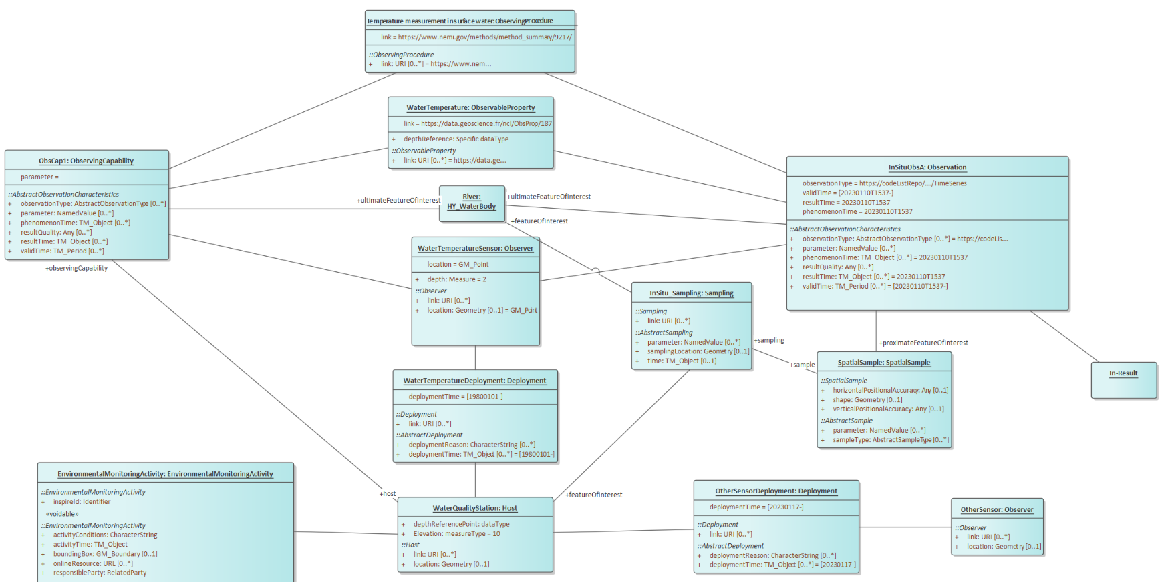
Conceptual Modelling
In situ sensor
SW_InSitu_QualityObservation (temperature, pH) => same pattern
Observing Procedure
Observed
Property
Station & Sensor Observing Capability
Observation & Result
Waterbody
Sensor
Spatial Sample
Deployment
Water Quality Station

Slide 37
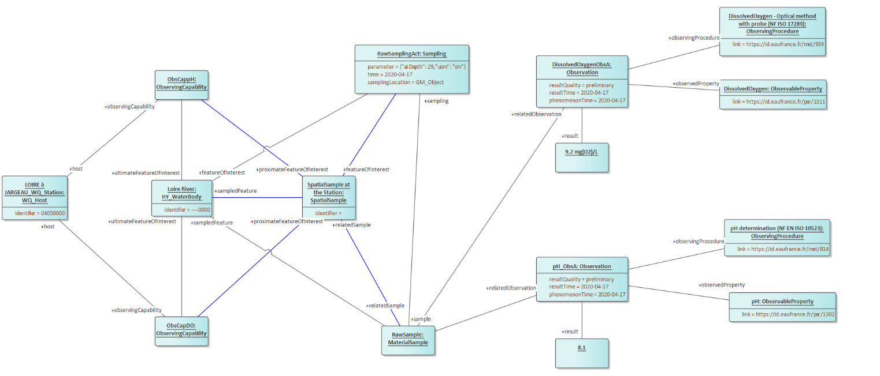
Conceptual Modelling
Ex situ = Lab
SW_ExSitu_QualityObservation (ex : Dissolved Oxygen, pH)
Observing Procedure
Sampling
DO Observation & Result
Observed
Property
Water Quality Station
Waterbody
SpatialSample
Observing Procedure
pH Observation & Result
Observed
Property
Material
Sample

Slide 38
Conceptual Modelling
Ex situ = Lab
SW_ExSitu_QualityObservation (ex : Dissolved Oxygen, pH)
Observing Procedure
Sampling
DO Observation & Result
Observed
Property
Water Quality Station
Waterbody
SpatialSample
Observing Procedure
pH Observation & Result
Observed
Property
Material
Sample

Slide 39
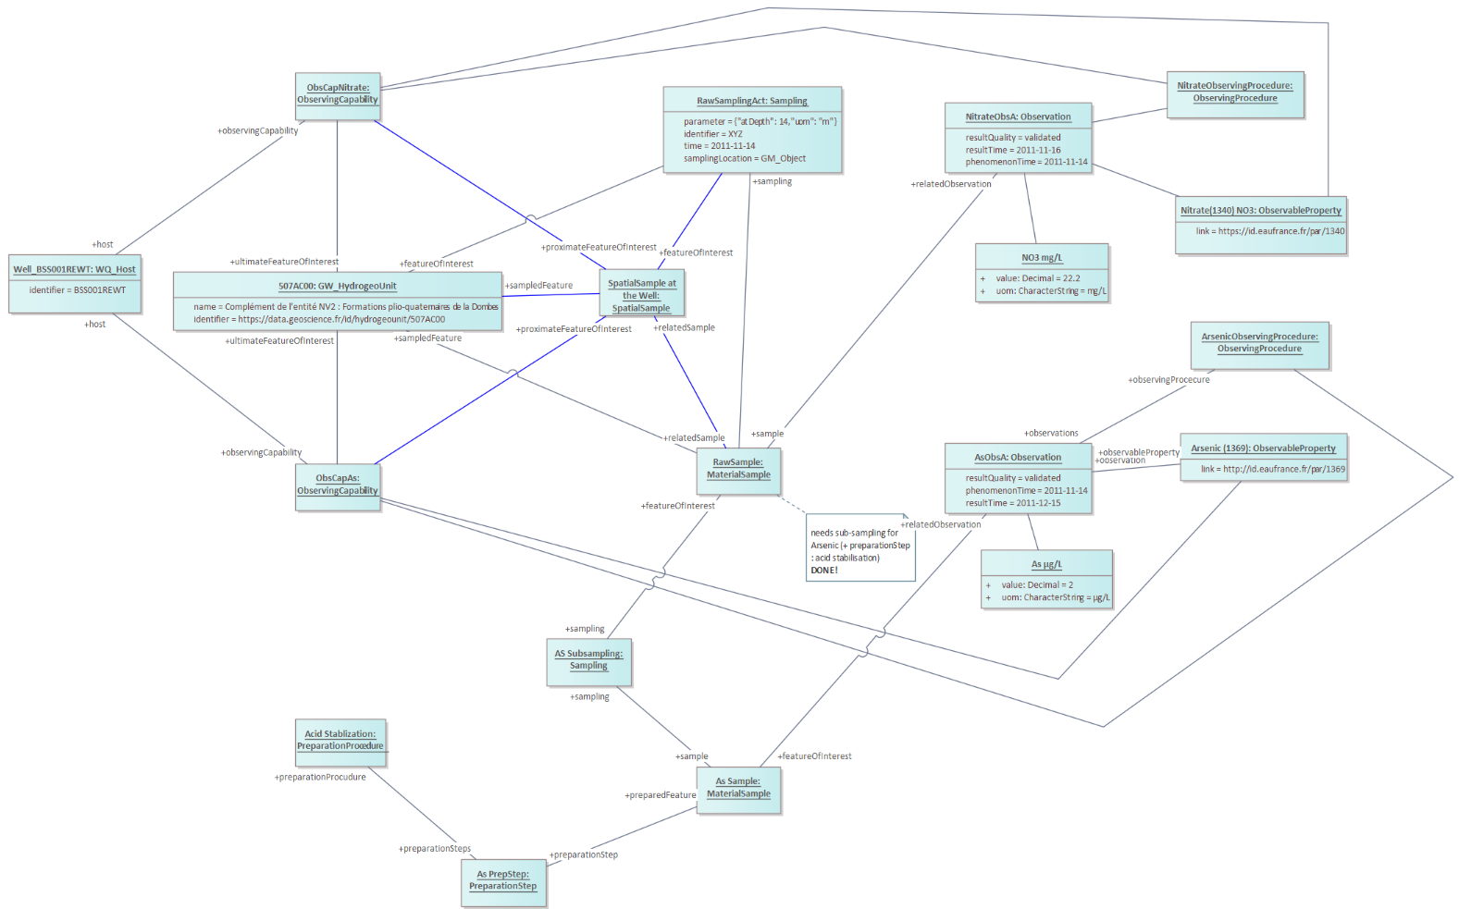
Conceptual Modelling
Ex situ = Lab
GW_ExSitu_QualityObservation (ex : Nitrate, Arsenic) => same pattern
Sampling
Observing Procedure
Nitrate Observation & Result
Observed
Property
Well
Hydrogeo Unit
SpatialSample
Observing Procedure
Material
Sample
Arsenic Observation & Result
Observed
Property
(sub)
Sampling
Material
(sub) Sample

Slide 40
Conceptual Modelling
Ex situ = Lab
GW_ExSitu_QualityObservation (ex : Nitrate, Arsenic) => same pattern

Slide 41
FAIR water quality data exchange thanks to international OGC water standards

Slide 42
Which interoperable / FAIR API ?
Available options
OGC WFS/API Features :
All the identified concepts are Features => could work
Not tied to a specific semantic/model and quite limited query mechanism on Observation topics
OGC SensorThings API
Semantics : Already Observations & Measurements compliant
Powerful query mechanism based on OASIS oData
Decision
Use OGC SensorThings API for Observation, Samples sharing and also a bit of River, Aquifer, Well information => core of the implementation, work presented here
Use OGC WFS / API – Features for pure geospatial features description / Use Cases : River, Aquifer, Well etc…

Slide 43
OGC SensorThings API?
An OGC standard for exchanging sensor data and metadata
Historic data & current data
JSON Encoded
RESTful
Adapting OASIS OData URL patterns and query options
Supporting ISO MQTT messaging
Easy to use & understandable
Discoverable with only a web browser

Slide 44
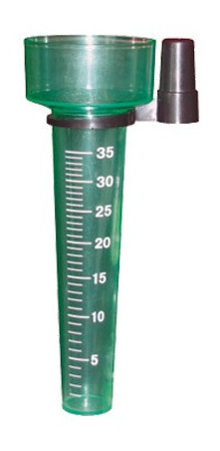
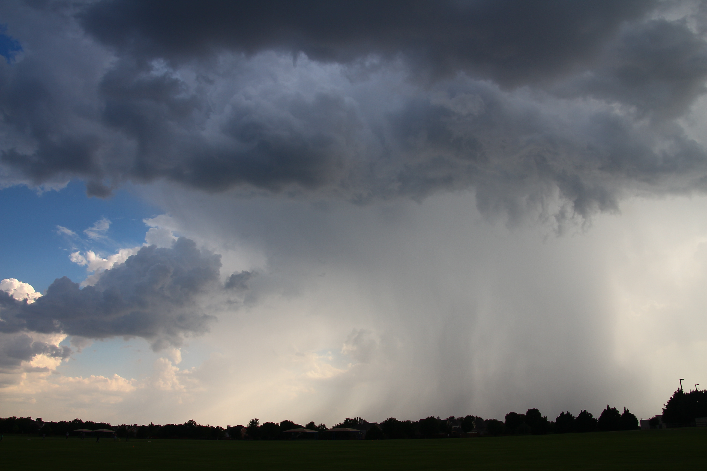
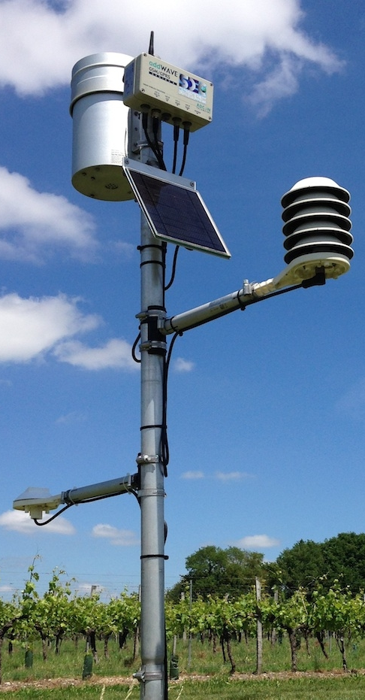
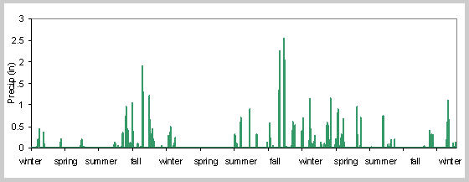
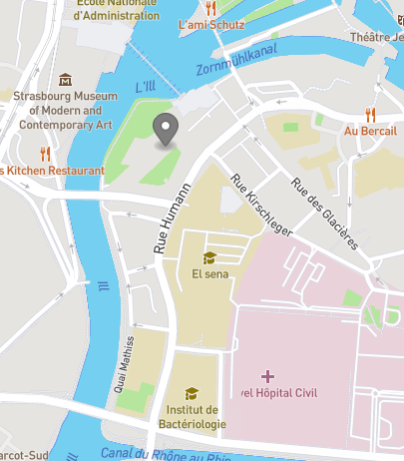
OGC SensorThings API?
Layman’s terms
Observation
method
Observed
property
Sensor type
= Rain gauge
= rainfall amount
 | "2021-05-07T09:50:00.000Z":"16.79
Observation
collection
Observation
Observer / Sensor / Station
= rainfall time series
Feature
of interest
Sensor intance = The Strasbourg meteo
station
= Representative zone
around the station

Slide 45
OGC SensorThings API?
Terms from the standard
Sensor
Observed property
Sensor type
= Rain gauge
= rainfall amount
 | "2021-05-07T09:50:00.000Z":"16.79
DataStream
Observation
Thing
= rainfall time series
Feature
of interest
Sensor intance = The Strasbourg meteo
station
Historical location
Location
= Representative zone
around the station

Slide 46
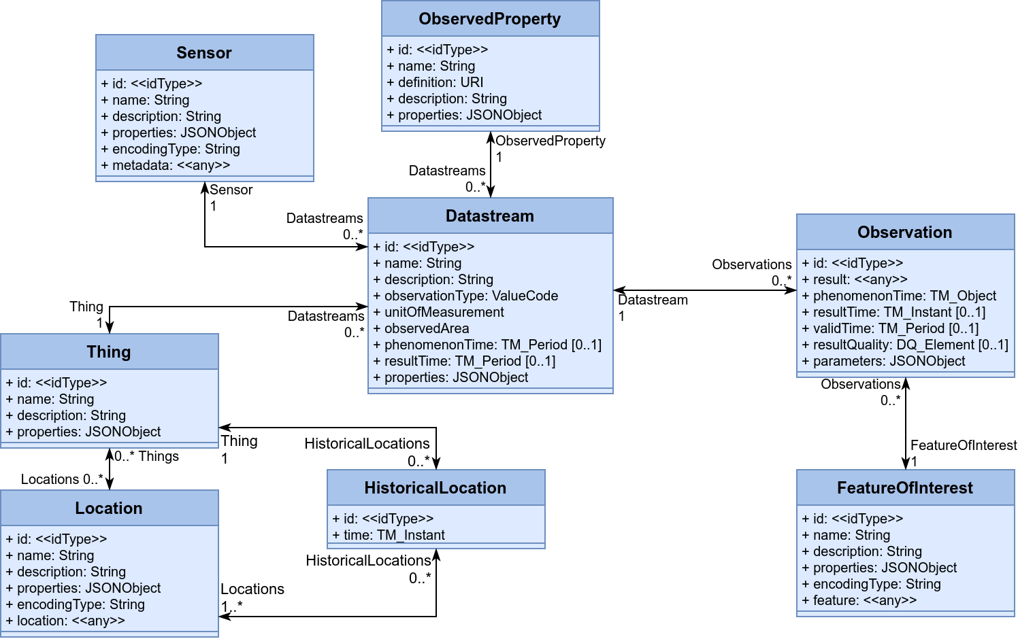
SensorThings API 1.1 – Data Model

Slide 47
SensorThings live demo
https://airquality-frost.k8s.ilt-dmz.iosb.fraunhofer.de/v1.1
~760 000 000 Observations
~21 000 Datastreams
~5 000 Stations
Docker Quick-Start: https://fraunhoferiosb.github.io/FROST-Server/deployment/docker.html
Full SensorThings API Tutorial https://fraunhoferiosb.github.io/FROST-Server/sensorthingsapi/1_Home.html

Slide 48
SensorThings API 1.1 – API
HTTP:
MQTT:
Subscribe
v1.1/Things
v1.1/Datastreams(x)
v1.1/Datastreams(x)/Observations
etc.
Get Notified
 | GET | POST | PATCH | DELETE
v1.1 | Get index
v1.1/Type | Get all of type | Create
v1.1/Type(id) | Get one of type |  | Update | Delete
v1.1/Type(id)/Entity | Get linked entity
v1.1/Type(id)/EntitySet | Get all linked | Create Linked
Fully Explorable with just a browser
Composable Responses
Powerful filtering
https://datacoveeu.github.io/API4INSPIRE/sensorthingsapi/1_Home.html

Slide 49
Fancy Queries
All data for a map: v1.1/Things?
$select=id,name,description,properties&
$top=10&
$filter=properties/countryCode eq 'HR'&
$expand=
Locations($select=location),
Datastreams(
$select=id,name,unitOfMeasurement;
$expand=
ObservedProperty($select=name),
Observations(
$select=result,phenomenonTime;
$orderby=phenomenonTime desc;
$top=1)
)
Link

Slide 50
Physical model -> Mapping to OGC SensorThings API
Map matching concepts
Monitoring Facility → Thing + Location
Observed Property → ObservedProperty
Observation Collection → Datastream
Observation → Observation
Observer → Sensor
Sample → FeatureOfInterest
Add missing Classes
SampledFeature (River)?
Deployment?
Sampler?
ObservingProcedure?

Slide 51
SensorThings API 1.1 – Water Quality
River? (SampledFeature)
Deployment?
Sampler?
ObservingProcedure?
Time series
Host
Sample +Location +Sampling

Slide 52
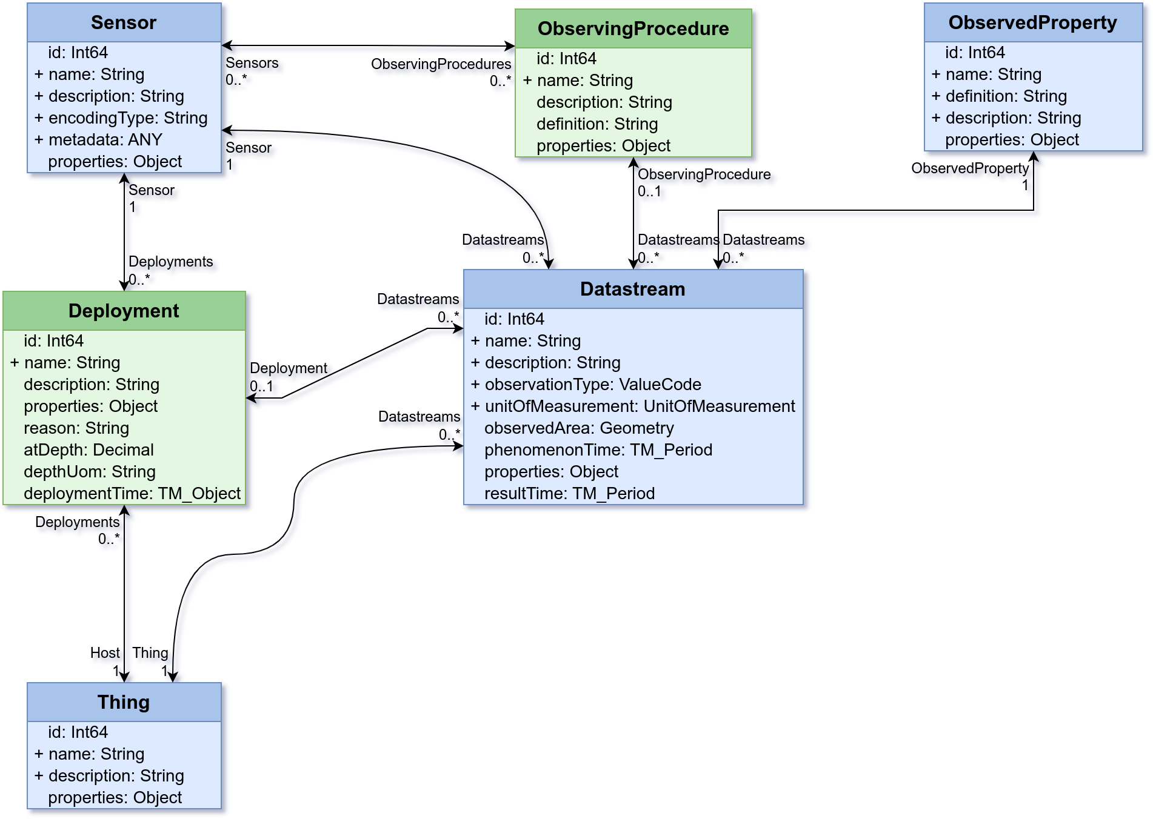
STA 1.1 WQ-IE – Sensor Extensions
Extending the Sensor
Deployment
ObservingProcedure
OMS addition

Slide 53
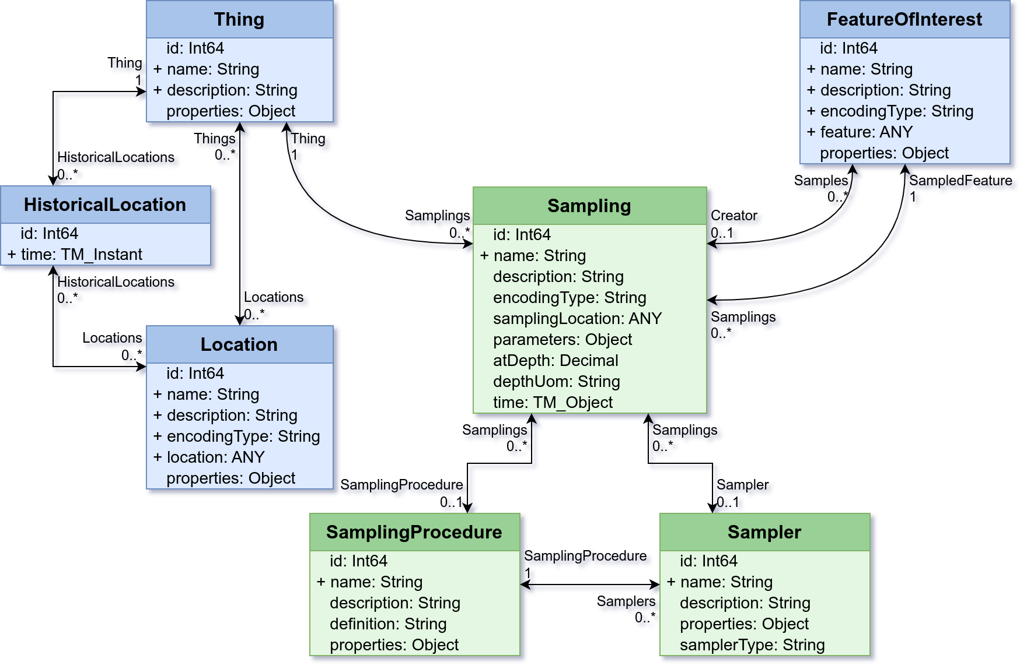
STA 1.1 WQ-IE – Sampling
Adding Sampling from OMS
Sampling
Sampler
SamplingProcedure
OMS addition

Slide 54
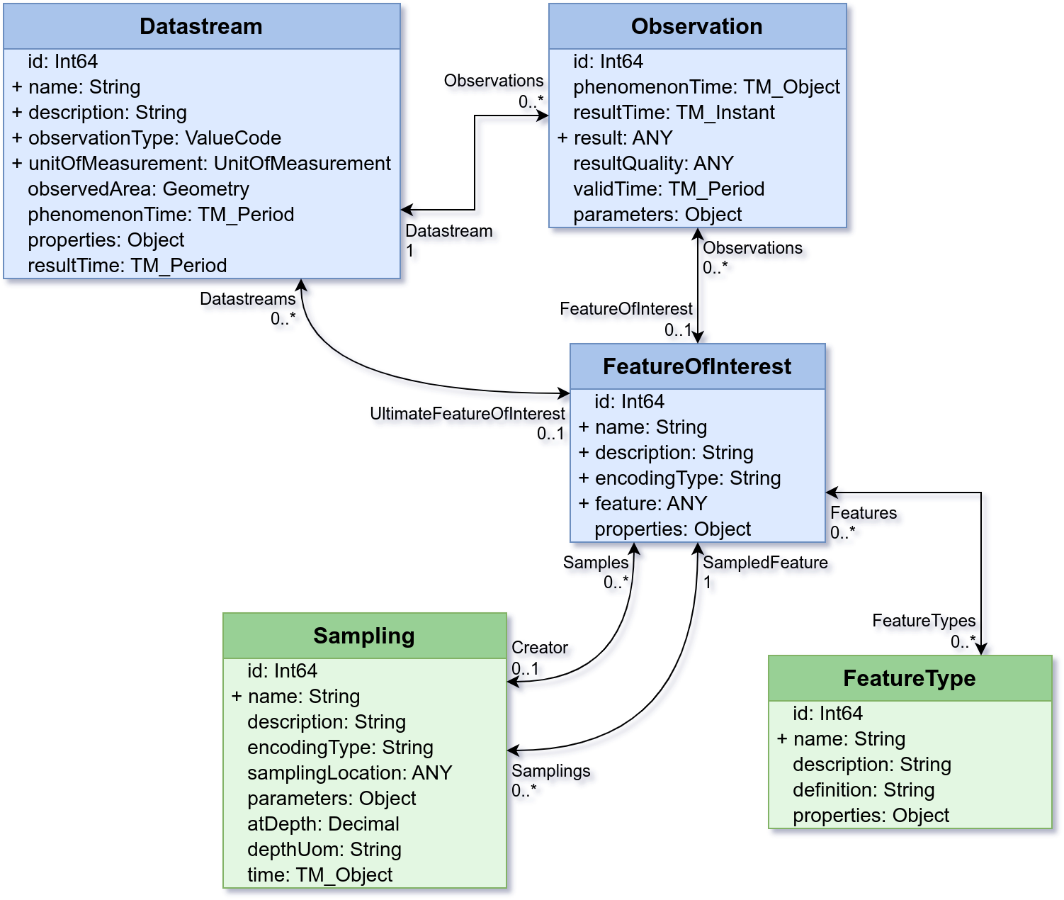
STA 1.1 WQ-IE – Features
Adding the River as Feature and linking a time series
FeatureType
Datastream → UltimateFeatureOfInterest
OMS addition

Slide 55
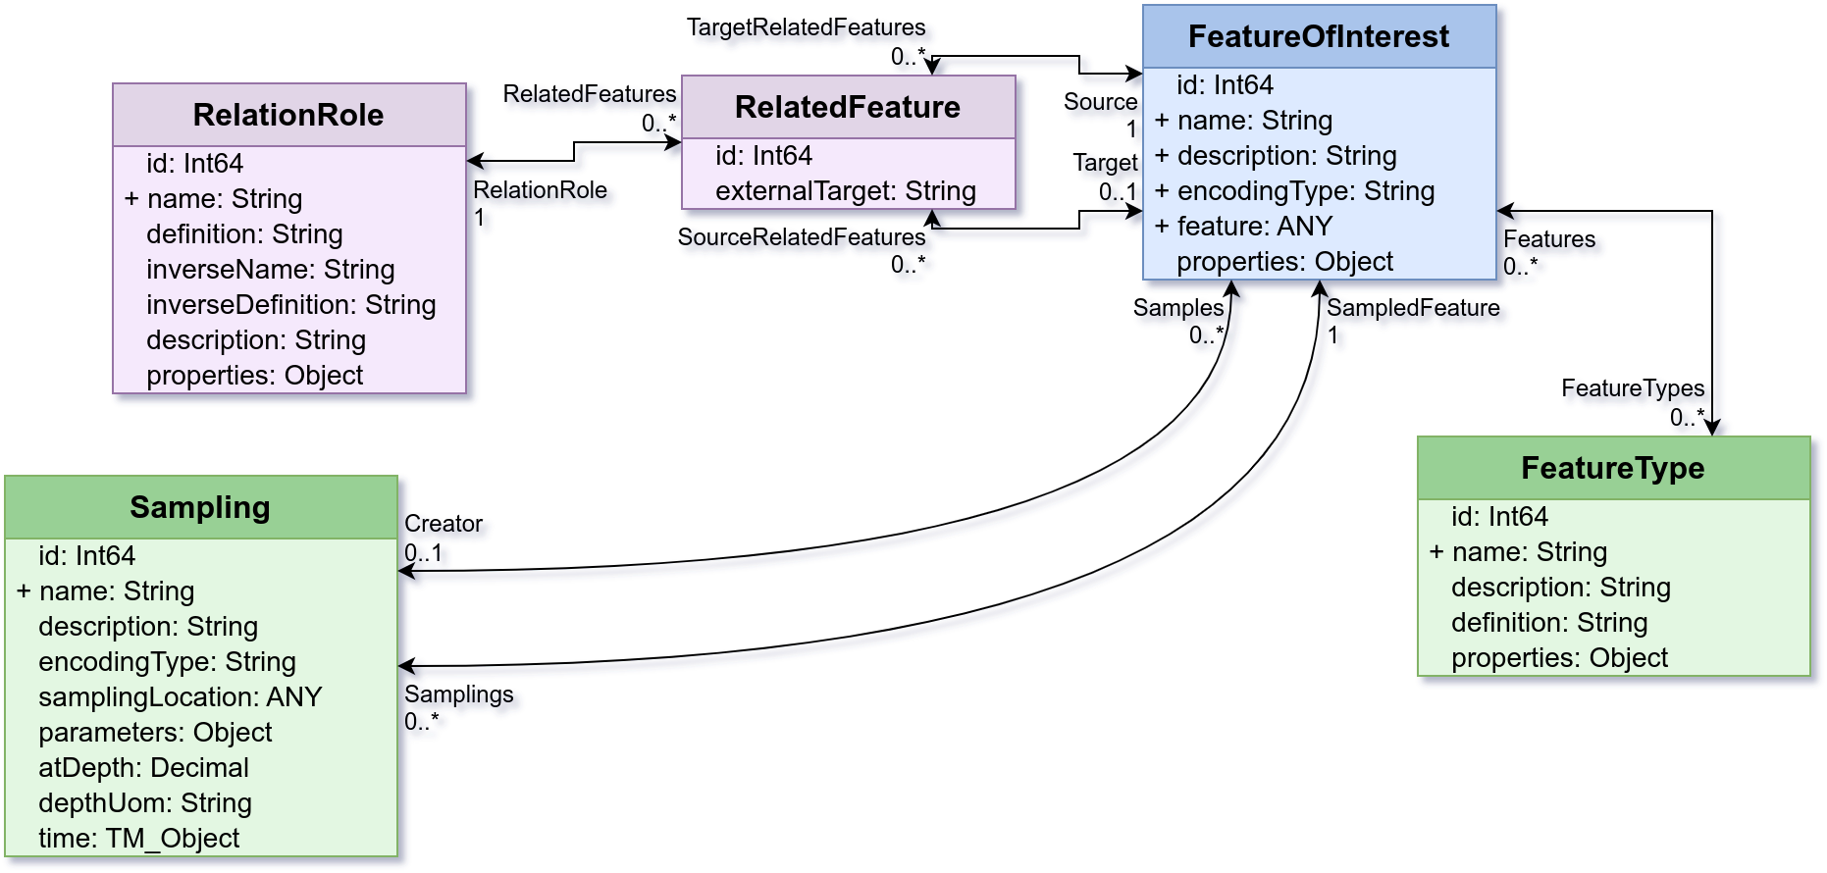
STA 1.1 WQ-IE – Relations
Relating Features to other Features
RelatedFeature
RelationRole
The same for:
RelatedThing
RelatedDatastream
RelatedObservation
Relation extension

Slide 56
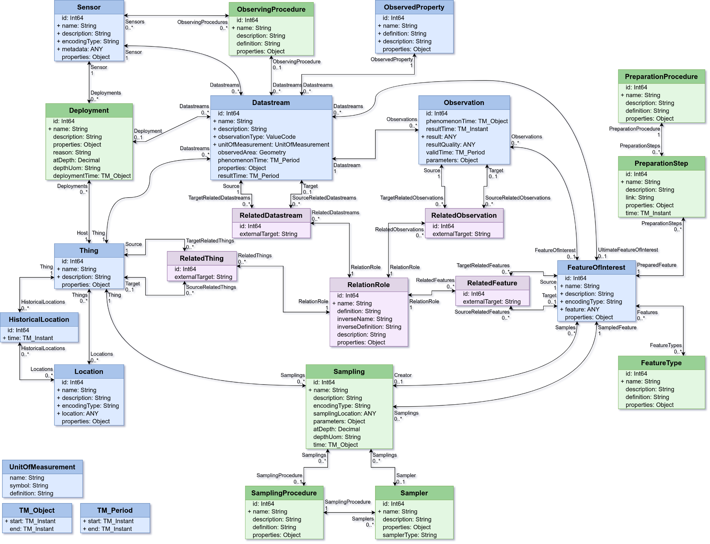
STA 1.1 WQ-IE
Full data model
Still v1.1 compatible
Paving the way to STA 2.0
STA 1.1
OMS addition
Relation extension

Slide 57
FAIR water quality data exchange thanks to international OGC water standards

Slide 58
Implementation
Who
Water Quality IE members USGS, USEPA, DataStream (Canada), BRGM, BaFG (Unesco Gems water), Fraunhofer
EU Water4All project partners
Ex : Danish DEP, ISPRA, Fraunhofer, VITO etc…
EU GSEU project partners
Many EU geological surveys
What
FROST Data Model Plugin https://github.com/hylkevds/FROST-Server.Plugin.WaterQualityIE
Docker Image https://hub.docker.com/r/hylkevds/frost-http-waterquality

Slide 59
Implementation
How
Documentation being written Google doc for now, will be moved to the GitHub when more mature https://docs.google.com/document/d/1Oqjxrz8uY_Q9OKBwEM2ZufrCEnlYvA4vWIIJSiMyGT4/edit
Demo endpoints
Open Free-For-All Service (no data yet) https://ogc-demo.k8s.ilt-dmz.iosb.fraunhofer.de/FROST-WaterQuality/v1.1/
USGS endpoint (work in progress) Data: https://wqp.wqie.internetofwater.app/FROST-Server/v1.1 Map: https://wqp.wqie.internetofwater.app/ Map: https://wg-brgm.k8s.ilt-dmz.iosb.fraunhofer.de/servlet/is/211/
Also tested in QGIS SensorThings API Plugin

Slide 60
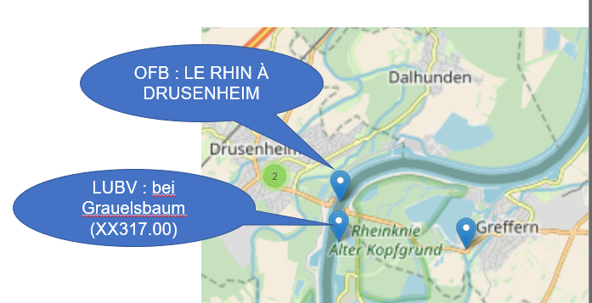
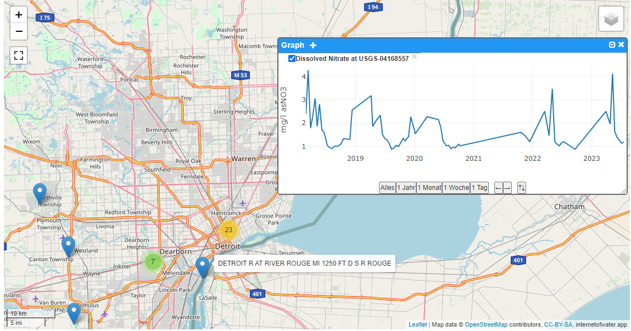
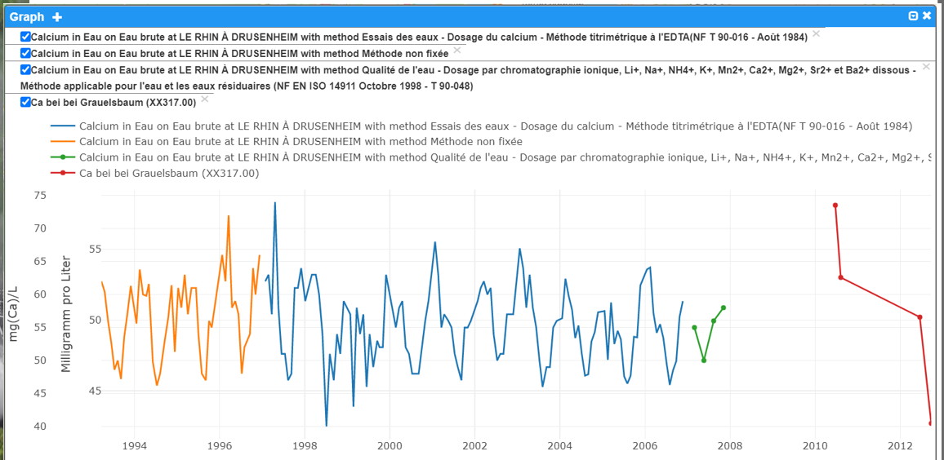
Implementation
It works !
Surface water quality
USGS – Internet of Water US
Surface water quality
France - Germany

Slide 61

Implementation
French & German Data
1 Map

Slide 62

Implementation
French & German Data
1 Map

Slide 63
FAIR water quality data exchange thanks to international OGC water standards
Conclusion

Slide 64
Landing the Interoperability Experiment
When
Current target => OGC Member Meeting in June 2024 (OGC Hydro DWG session)
What
Demo based on the implementation feedback
+ draft Engineering Report
summarizing the findings from the IE
and proposing next steps. Ex : adoption of a Best Practice for Water Quality data exchange Water ML2.0 Part 5 and (potentially) a revision of WaterML2.0 Part 1 : TimeSeries

Slide 65
Steps after the Interoperability Experiment
Finalize a Best Practice for Water Quality data exchange Water ML2.0 Part 5 and start a draft revision of WaterML2.0 Part 1 : TimeSeries (to align with OMS and ST API )
Work on shared ‘controlled’ vocabularies
Observed Property (? using I-ADOPT ? ), Observing Procedure, …
Current UseCases
More implementations : La Plata basin countries (through WMO), more Water4All and GSEU project partners
Address the other UseCases
Out of scope this IE : Biology (taxa observation), Hydro Models, Remote Sensing
Enough material for a WQ IE 2 ☺

Slide 66
Some hindsight on the effort
How the new “Observations, measurements and samples (OMS) ” is meaningful to the Interoperability Experiment ?
Most of what is needed semantically is already within the OGC semantic baseline : OMS + OGC WaterML2.0 part 3 (HydroFeatures) and part 4 (GroundWaterML 2.0)
OGC SensorThings API 1.1 being already Observations & Measurements compliant we just needed to add the missing elements to make it OMS compliant (ex : MaterialSample and some others)
This is now embedded in SensorThings 2.0 working draft (revision ongoing)

Slide 67

Some hindsight on the effort
How the new “Observations, measurements and samples (OMS) ” is meaningful to the Interoperability Experiment ?
=> No need to reinvent the wheel, just use the available standards and document it

Slide 68


Some context supporting this work
Some supporting national /EU projects from our end (both running now)
French Research project, 53 Million €, 10 years
https://www.onewater.fr/en (ANR project : 22-PEXO-0009)
Many domain objectives including FAIR (interoperable) Water Data Exchange
EU joint research partnserhip
https://www.water4all-partnership.eu/
31 countries, 7 years, 81 Million € for the 2 years.
Many domain objectives including FAIR (interoperable) Water Data Exchange
Your project could join the effort
join the OGC Hydro DWG discussions

Slide 69
Thank you
s.grellet@brgm.fr

Slide 70


Thank to
Hylke van den Schaaf
hylke.vanderschaaf@iosb.fraunhofer.de
Kathi Schleidt
Kathi@DataCove.eu

